Slide 1
DEPARTMENT OF ZOOLOGY

Slide 2
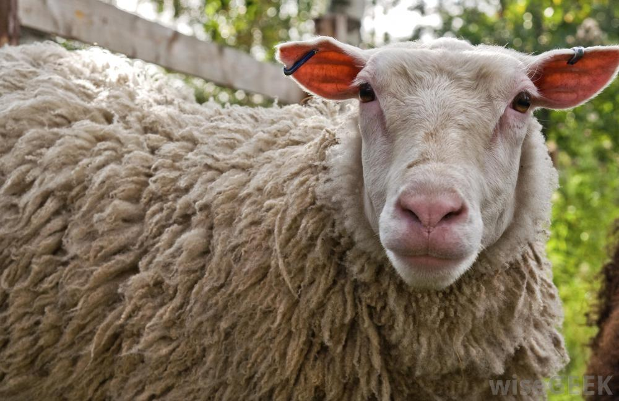
EMBRYO CLONING
BY PADMAVATHI

Slide 3
EMBRYO CLONING
Cloning is defined as the production of one or more individual plants or animals that are genetically identified to another plant or animal.
Clone is defined as
1.A group of organisms of identical genotype.
2.A group of cells descended from a single parent.

Slide 4
PROCEDURE
Differentiated mammary cells are extracted from parent sheep and they are grown in nutrient deficient solution to stop the cell cycle.
Undifferentiated egg cell are extracted from egg donor .
Nucleus is removed and discarded.
Mammary gland cell is placed next to e-nucleated egg cell.
Electric shock causes the two cell-membranes to fuse, and mitosis to trigger.
Mitotic division continues producing embryo.

Slide 5
Embryo is implanted into surrogate mother. After 5- month gestation dolly the lamb born with identical genotype to parent donating nucleus from mammary cell.
There are 3 different types of cloning are:
Embryo cloning
Adult DNA cloning
Therapeutic cloning.

Slide 6
EMBRYO CLONING
This is a technique of producing monozygotic twins or triplets .In this process one or more cells are removed from a fertilized embryo and encouraged to develop into one or more duplicate embryos. This has been done for many years in animals , limited in humans.

Slide 7
ADULT DNA CLONING
It is a technique intended to produce a duplicate of an existing animal. It has been used to clone a sheep and other mammals . The DNA from an ovum is removed and replaced with the DNA from a cell removed from an adult animal. It is implanted in a womb and allowed to develop into a new animal.

Slide 8
THERAPEUTIC CLONING
This is similar to adult DNA cloning in its initial steps. The stem cells are removed from the pre embryo with the intent of producing tissue or a whole organ for transplant back into the same person who supplied the DNA.
The goal of therapeutic cloning is to produce a healthy copy of a sick persons tissue or organ for transplant.
The tissue or organ would have the sick persons original DNA.
The patient need not take immune suppressant drugs so, the rest of their life, as is now required after transplant. There would not be any danger of organ rejection.

Slide 9
ADVANTAGES
By using cloning the DNA from the cell of an adult with the desired traits or talents might produce and infant with similar potential.
A heterosexual couple in which the husband was completely sterile could use adult DNA cloning to produce a child.

Slide 10
DRAWBACKS
There is no guarentee that the first cloned humans will be normal.
The foetus might suffer from some disorder that is not detectable by ultrasound.
They may be born disabled.

