Slide 1

DEPARTMENT OF ZOOLOGY

Slide 2

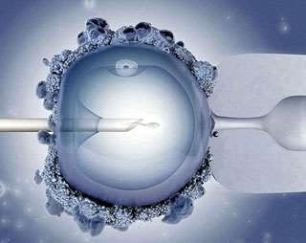
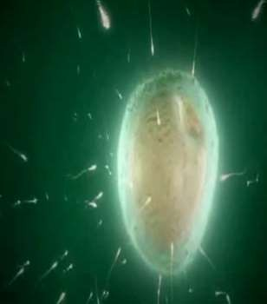
In-vitro Fertilization

Slide 3

Introduction
In vitro fertilisation (IVF) is a process by which an egg is fertilised by sperm outside the body: in vitro.
Evolved as a major treatment protocol for infertility.
The term in vitro, from the Latin meaning in glass, is used, as early biological experiments involving cultivation of tissues outside the living organism were carried out in glass containers such as beakers, test tubes, or petri dishes.
A colloquial term for babies conceived as the result of IVF, is "test tube babies“.

Slide 4

History of IVF
1890 - The very first in vitro manipulation of eggs/ embryos was performed by Walter Heape , when he transferred in vivo fertilized eggs from one female rabbit to another.
1959 - M.C. Chang, successfully conducted IVF in rabbits.
February 15, 1969, the journal Nature published a paper authored by R.G. Edwards, B.D. Bavister and
P.C. Steptoe: “Early stages of fertilization in vitro of human oocytes matured in vitro”
1977, the first IVF pregnancy in human and the birth of Louise Brown.

Slide 5
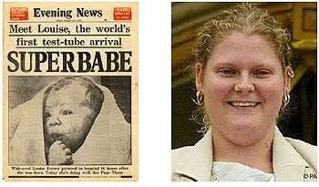
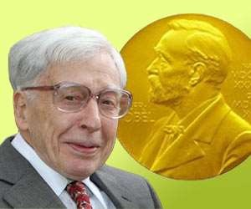
History of IVF
Worlds first test tube baby, Louise Brown turns 36 in 2014
In 2010, Sir Edwards was awarded the Nobel Prize in Physiology or Medicine "for the development of in vitro fertilization"

Slide 6


History of IVF
The Indian angle
Dr. Subhash Mukhopadhyay (16 January 1931 – 19 June 1981) was a physician from Kolkata, India, who created the world's second and India's first child using in-vitro fertilisation, Durga who was born 67 days after the first IVF baby in United Kingdom.
Unfortunately, he was harassed by the state government, and not allowed to share his achievements with the international scientific community.
Dejected, he committed suicide on 19 June 1981.
The critically acclaimed film Ek Doctor Ki Maut (1990) was made on his life

Slide 7

Indications of IVF
IVF is most clearly indicated when infertility results from one
or more causes having no other effective treatment;
  Tubal disease. In women with blocked fallopian tubes, IVF has largely replaced surgery as the treatment of choice.
  Endometriosis. Patients with endometriosis, often have tubal involvement and ovarian cysts (endometrioma).
  Ovulatory dysfunction. In patients with polycystic ovarian disease
(PCOS) and other ovulatory problems.
  Age Related Infertility. In normal reproductive life, a woman's ovarian function is diminished with age. In many cases, this reduced function can be overcome through the use of IVF
  Male Factor Infertility. Azoospermia, oligozoospermia,
asthenozoospermia, anti-sperm antibody etc.
  Preimplantation Genetic Testing (PGT). Genetic testing on pre- implantation embryos may be indicated for patients who are at risk for genetic disorders such as Cystic fibrosis and Thalassemia

Slide 8
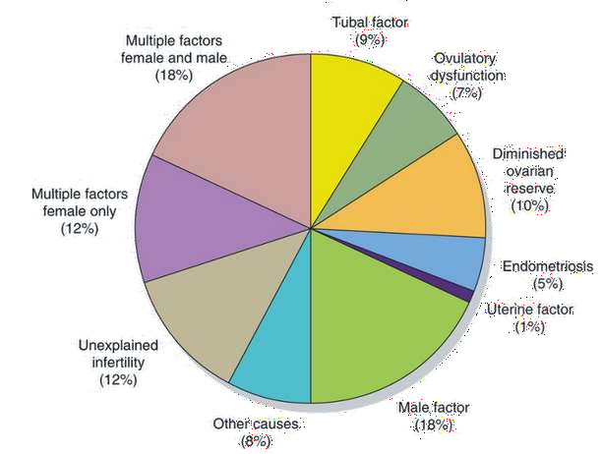
Indications of IVF
Diagnosis among couples using IVF technology
(Centres for Disease Control and Prevention, 2013 IVF Success Rates. National Summary and Fertility Clinic Reports. Atlanta, GA, 2013.)

Slide 9

Steps in IVF (the IVF cycle)
Initial evaluation
Suppression of natural hormonal cycle
Ovarian stimulation
Collection of oocytes
Collection of sperms
In vitro fertilization of oocytes
Embryo transfer

Slide 10


Initial Evaluation
Blood tests
Seminal Fluid examination
Hysterosalpingogram
Trans vaginal ultrasound

Slide 11



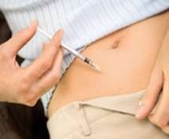

Suppression of natural hormonal cycle
Suppression drugs prevent spontaneous ovulation.
In an IVF cycle, it is important that natural ovulation should not occur - if the eggs leave the ovary, the doctor will not be able to retrieve them.
Drugs used :
  Oral contraceptive pills – each day starting
cycle day 1, 2 or 3 for approximately 2-4 weeks
  Lupron / Leuprolide Acetate – GnRH Agonists. It suppresses LH surge preventing eggs from being released before they are mature for egg retrieval. Subcutaneous inj every morning
  Nafarelin - GnRH Agonists, three times a day nasal spray.
  Ganirelix Acetate Injection / Cetrotide - GnRH antagonists -

Slide 12


Ovarian stimulation
Ovarian stimulation is used to produce multiple mature follicles, rather than the single egg normally developed each month.
Produces many good follicles to be Fertilized.
Multiple eggs are stimulated because some eggs will not fertilize or develop normally after fertilization.
Regular monitoring by ultrasound scan is done.

Slide 13

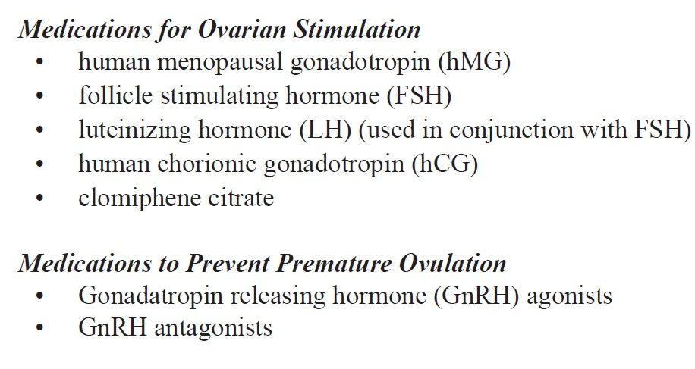
Ovarian stimulation
Generally, eight to 14 days of stimulation is required.

Slide 14
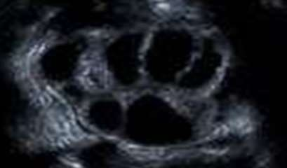
Ovarian stimulation
Ovarian follicles, stimulated by ovulation medications, visible on ultrasound. The dark, circular areas are the follicles.
Possible Side Effects of ovarian stimulation
Discomfort, bruising or swelling at injection site
Rash
Allergic sensitivity
Headache
Mood swings
Abdominal discomfort and bloating
Chance of multiple pregnancies
Ovarian Hyperstimulation Syndrome (OHSS)

Slide 15








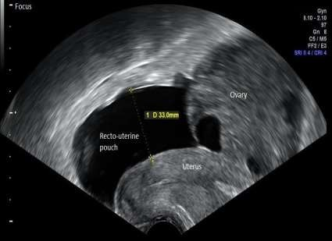
Ovarian stimulation
Ovarian Hyperstimulation Syndrome (OHSS)
Ovarian hyperstimulation can result in enlargement of the ovaries with leakage of fluid into the abdomen and rarely into the lungs.
Most cases are mild, but a small proportion are severe and fatal.
Treatment of OHSS depends on the severity of the
hyperstimulation. Mild OHSS can be treated conservatively
If moderate to severe OHSS develops the IVF process should be postponed since establishment of pregnancy can lengthen the recovery time or contribute to a more severe course.

Slide 16



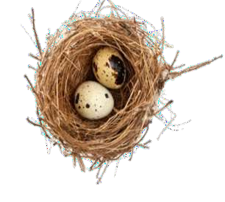
Collection of oocytes
The oocyte maturation is performed, generally by an injection of human chorionic gonadotropin (hCG). Commonly, known as the "trigger shot.“
The egg retrieval is performed at a time usually between 34 and 36 hours after hCG injection.
Egg retrieval is usually accomplished by transvaginal
ultrasound aspiration.
It is done under short general anesthesia, and is 20 to 30 minutes procedure.
In some circumstances, one or both ovaries may not be accessible by transvaginal ultrasound. Laparoscopy may then be used to retrieve the eggs using a small telescope placed in the umbilicus.

Slide 17

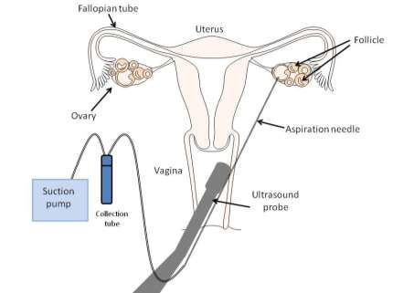
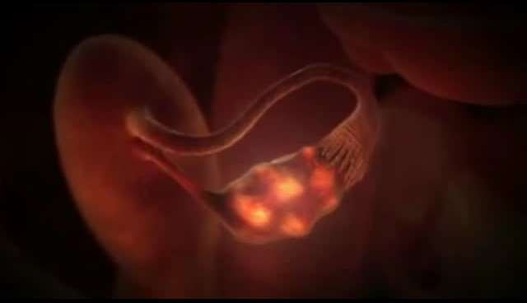
Collection of oocytes
The eggs are aspirated (removed) from the follicles through the needle connected to a suction device.

Slide 18
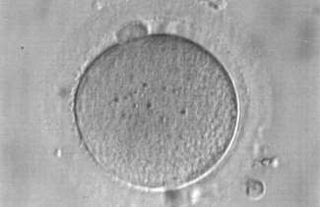
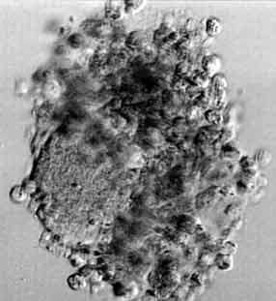
Collection of oocytes
Usually around 10-15 oocytes are aspirated
The eggs are prepared and stripped from the surrounding cells.
After the eggs are retrieved, they are examined in the laboratory for maturity and quality.
Mature eggs are placed in an IVF culture medium and transferred to an incubator to await fertilization by the sperms

Slide 19



Collection of sperms
Shortly before or after the oocyte collection the male
partner will be asked to give a sperm sample.
Sexual abstinence of 3-4 days should b exercised.
Collected about 60-90 minutes prior to fertilization,.
Liquefied ,centrifuged, suspended in culture medium, and
incubated for 30-60 mins at 37⁰ C.
The most active sperms are located in the surface of the medium.
Sperm may be obtained from the testicle, epididymis, or vas deferens from men whose semen is void of sperm either due to an obstruction or lack of production.

Slide 20



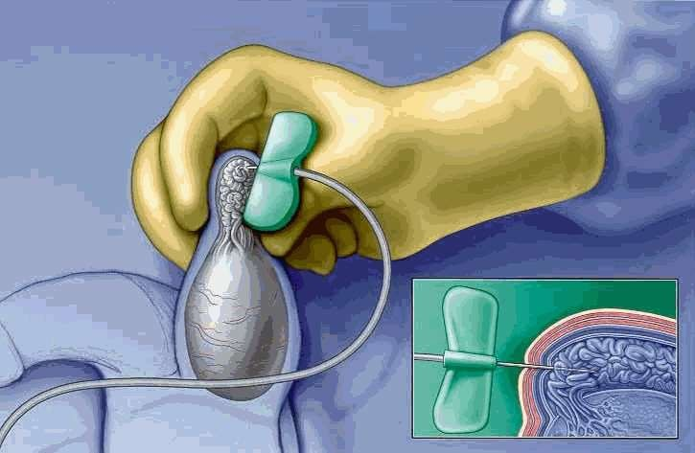
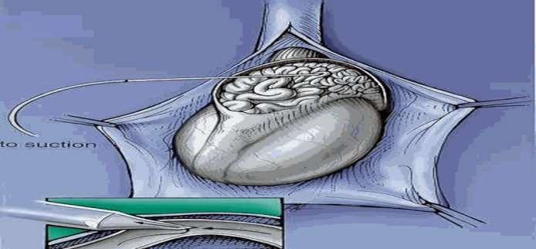
Collection of sperms
Surgical sperm retrieval
Percutaneous epididymal sperm aspiration (PESA)
Microsurgical epididymal sperm aspiration (MESA)

Slide 21


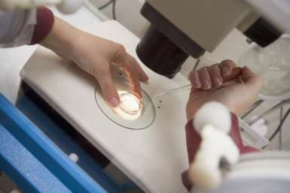
In vitro fertilization of oocytes
Fertilization is started by adding 10,000-50,000 motile sperms to about 100 µl to 1 ml culture medium in which the oocytes is being incubated.
Intra-cytoplasmic sperm injection (ICSI) is indicated in cases where semen fluid does not contain sperm.

Slide 22


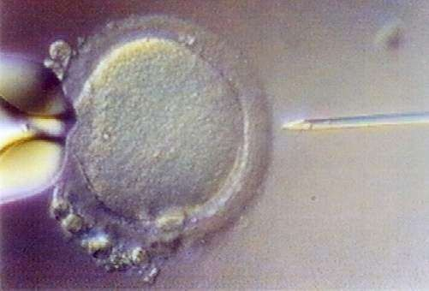
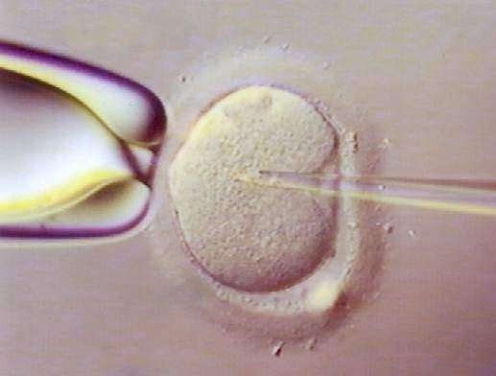
In vitro fertilization of oocytes
Intra-cytoplasmic sperm injection (ICSI)
During the process of ICSI, an embryologist isolates a sperm cell, draws it up into a microscopic needle and injects it inside an oocyte using a high power microscope.
An oocyte is held in place with the large holding pipette on the left, while the smaller pipette is used to pick up a single live sperm.
This pipette is then manipulated to pierce the oocyte cell membrane and the sperm is injected into the cytoplasm .

Slide 23

In vitro fertilization of oocytes
Fertilisation check is performed the next day approximately 18 hours after sperm injection or insemination of the eggs.
Usually 65% to 75% of mature eggs will fertilize after insemination
They are cultured in special incubators to support division and development.
If the couple has a history of certain genetic disease and the gene that is causing that problem is identified, a pre-implantation genetic diagnosis may b done.

Slide 24


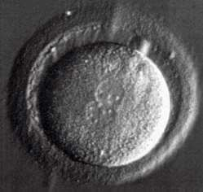
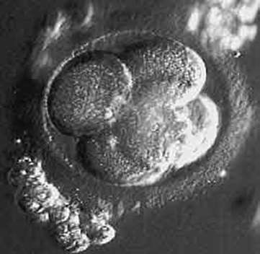
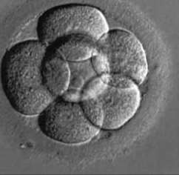
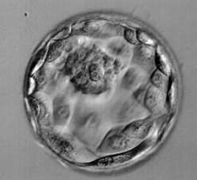
In vitro fertilization of oocytes
Development of embryo
Day 1: 2 cell stage
male and female pronuclei
Day 2: 4 cell stage
Day 3: 8 cell stage
Day 5: blastocyst (200-300 cell)

Slide 25

Embryo transfer
Embryo transfer may be performed on day 2, 3 or 5 post fertilization.
One or more embryos suspended in a drop of culture medium are drawn into a transfer catheter, a long, thin sterile tube with a syringe on one end.
The physician gently guides the tip of the transfer catheter through the cervix and places the fluid containing the embryos into the uterine cavity

Slide 26
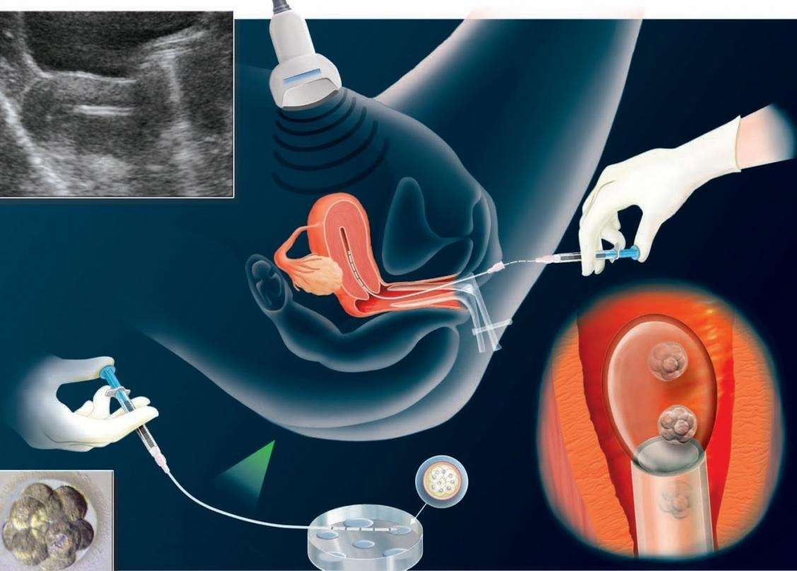
Embryo transfer

Slide 27
Embryo transfer
How Many Embryos are Transferred?
Related to age and embryo quality
o <35 = 2
o 35-37 = 2-3
o 38-40 = 3-4
o >40 = up to 5
For patients with 2 or more failed IVF cycles, or a poor prognosis, can add more based on clinical judgement

Slide 28




What are the percentages of success?
Women's age
Other Statistics
Other Factors
Less than 35 years old (41-43%). In our center, 65-70%.
Between 35-37 years old (33-35%). In our center, 50- 55%.
Between 38-40 years old (23-27%). In our center, 30-35%.
After 41 years old (13- 18%). In our center, 20- 22%.
Repetition of four trials: success rate (70- 80%).
Repetition of after three trials: success rate (60- 65%).
If four embryos are transferred the percentage of success becomes 40%.
If three embryo transfer the percentage 35%.
If two embryo transfer
the percentage 25%.
One embryo carry 17% success rate.
increasing the number of embryos transferred, the success rate increases
risk of multiple pregnancies increases and miscarriage increases
Quality of the eggs and sperm.
Number and quality of embryos

Slide 29
Variations of IVF
Gamete intrafallopian transfer (GIFT) is similar to IVF, but the gametes (egg and sperm) are transferred to the woman’s fallopian tubes rather than her uterus, and fertilization takes place in the tubes rather than in the lab.
Zygote intrafallopian transfer (ZIFT). This technique differs from GIFT in that fertilization takes place in the lab rather than the fallopian tube, but is similar in that the fertilized egg is transferred to the tube rather than the uterus.
They both comprises less than 1% of IVF procedures performed worldwide.

Slide 30
….…its over!!!!
Thank you!

