Slide 1
DEPARTMENT OF ZOOLOGY

Slide 2
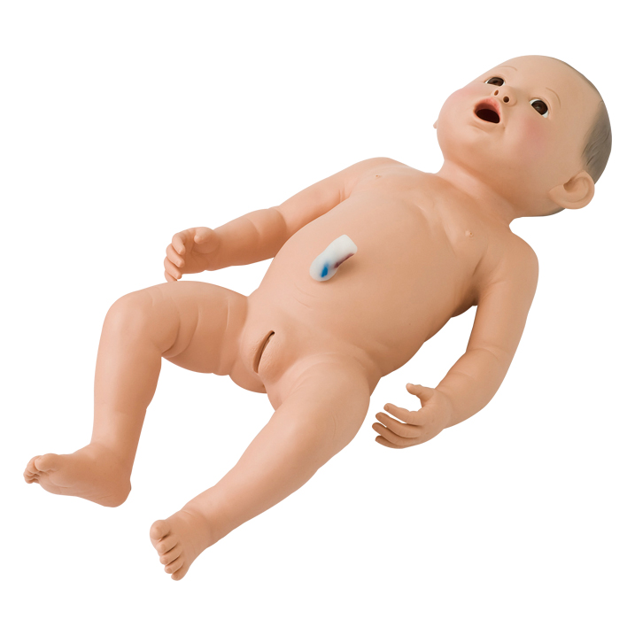
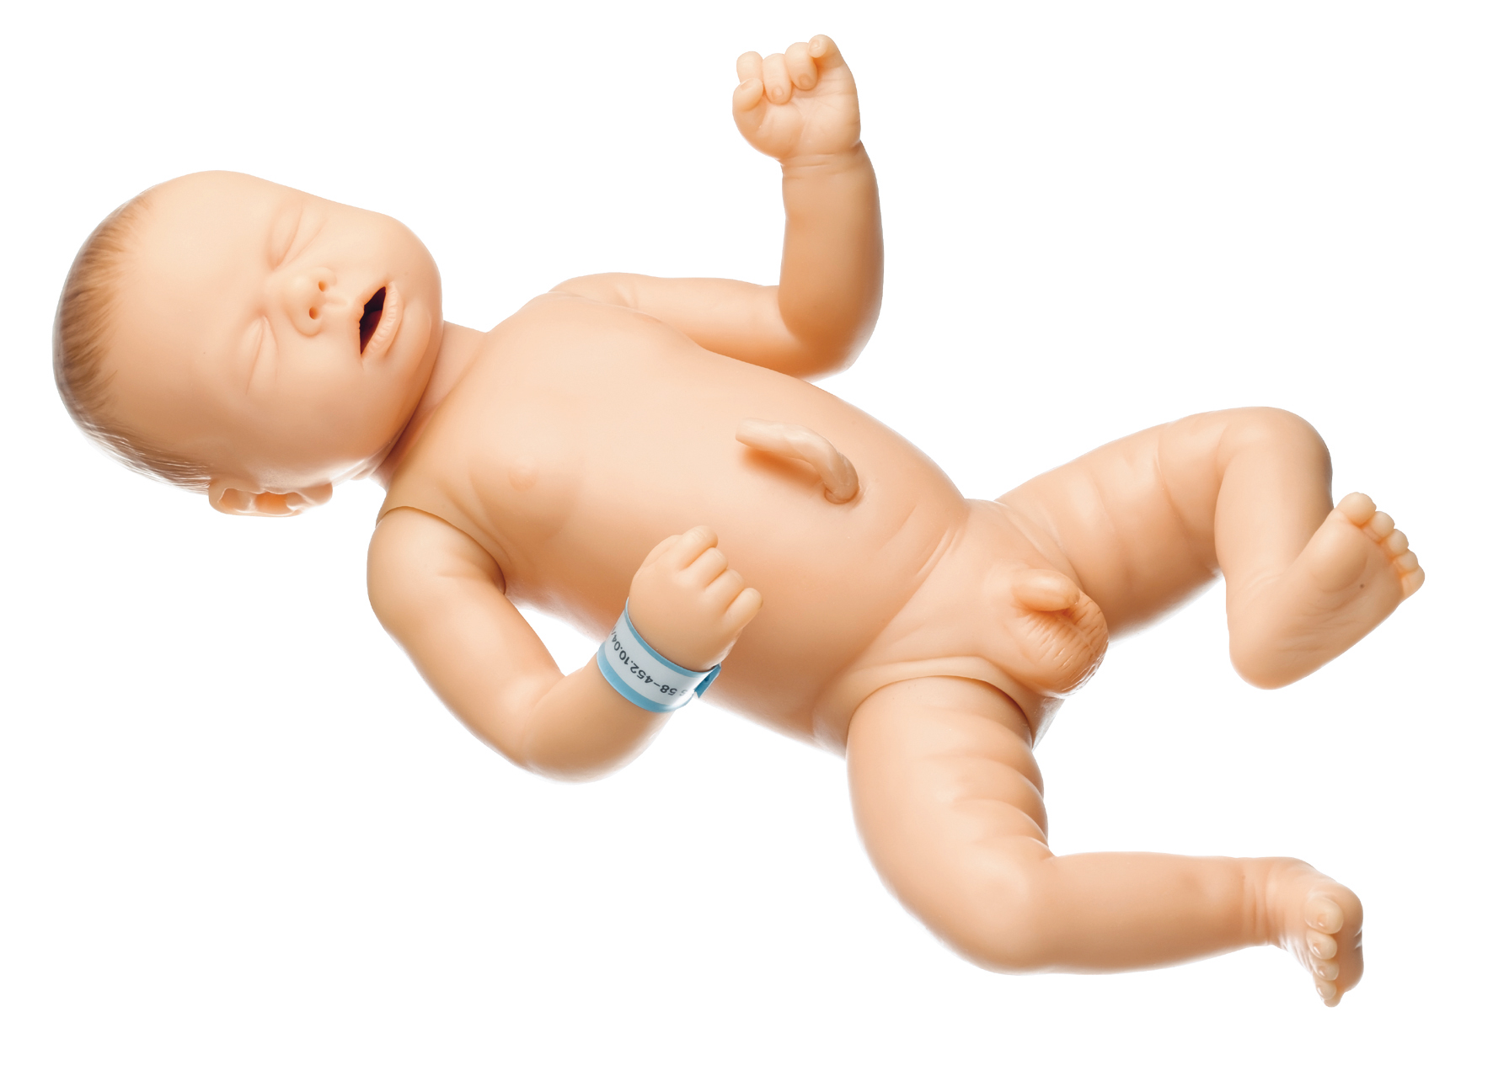
SEX DETERMINATION
KOLLA SWATHI
BSC CBZ

Slide 3
DEFINITION
A sex determination system is a biological system that determines the development of sexual characteristics in an organism.

Slide 4
INTRODUCTION
The sexually producing organisms may be classified into two types:
Monoecious or Bisexual
Dioecious or Unisexual
Here the male and female organisms are identified by the primary sex organs they poses such as Testes and ovaries respectively, in addition to the sexual organs difference in size or appearance between sexes is called as sexual dimorphism.
The phenomenon of sexual dimorphism has been a riddle for biologists for a long time.
Now it is clear that chromosomes and genes play a vital role in the determination of sex.

Slide 5
Sex determination mechanism in dioecious organisms
Experiment of Henking
H. Henking a German biologist, while studying in the spermatogenesis of the squash bug pyrrhocoris, he noticed that half the spermatozoa possessed an extra chromosome which he called “X” body
But he did not speculate on the significance of this body.

Slide 6
Experiment of Mc Clung
He observed that xiphidium fasciatun contained 24 chromosomes whereas the male contained only 23
He suggested that “X” Body was involved in the sex determination of this insect.
But he erroneously considered it to be peculiar to males, because he could not succeed in tracing the Oogenesis of female.

Slide 7
Experiment of Steven and Wilson
They both were successfully followed both Oogenesis and Spermatogenesis in some bugs of protenor.
In these insects they observed difference in the chromosomal number in both male and female sexes.
The female carried 14 and male 13 chromosomes.
The female producing eggs with 7 chromosomes each and male producing 2 types of sperms, one with 7 and another with 6 chromosomes only.
So, the eggs fertilized by sperms of 7 chromosomes developed into females and those fertilized by sperms of 6 chromosomes developed into males.
And also they found another type of sex determination in milk weed bug, Lygaeus turcicus
It carries same number of chromosomes in both sexes
But the male have heterologous chromosomes ie X and Y.

Slide 8
Types of formation of germ cells
There are two systems of formation of germ cells in males and females.
Male hetero and female homogametic type: In this system the females are known to produce similar eggs, all with one x chromosome, so the female is known as homogametic sex.
In males half the sperms produced carry x chromosomes while the
other half carry no x chromosomes, so the male is known as hetero gametic
First example: XX-XO type in order hemiptera and orthoptera

Slide 9
Types of formation of germ cells
Second example: XX-XY type in man and other mammals.

Slide 10
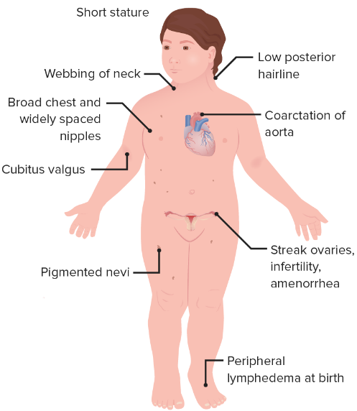
Importance of Y Chromosome in man
In man the Y chromosomes is essential for determining the masculinity as well as male fertility.
The conclusive evidence that Y chromosome is a determiner of fertility and sex in male came from certain abnormalities or syndromes.
There are two such importance syndromes
Turners syndrome or XO type
In these persons the chromosomal
Number appears as 45, as 1
Chromosome is missing.

Slide 11
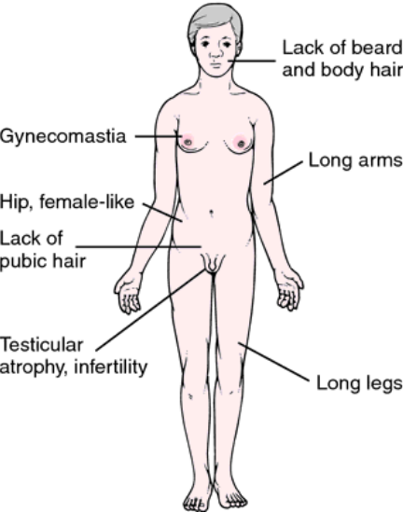
2. Klinifelter syndrome
It is XXY type. These persons will have 47
Chromosomes instead of normal 46

Slide 12
Types of formation of germ cells
2. Male homogametic and female heterogametic type: in this females are heterogametic and males are homogametic
First example: ZO-ZZ type

Slide 13
Types of formation of germ cells
Second example: ZW-ZZ type

Slide 14
Other theories of sex determination
There are mainly five theories to explain the phenomenon of sex determination
Theory of alternate dominants
Theory of metabolic difference
Quantitative theory
Theory of heterozygosity
Theory of genic balance

Slide 15
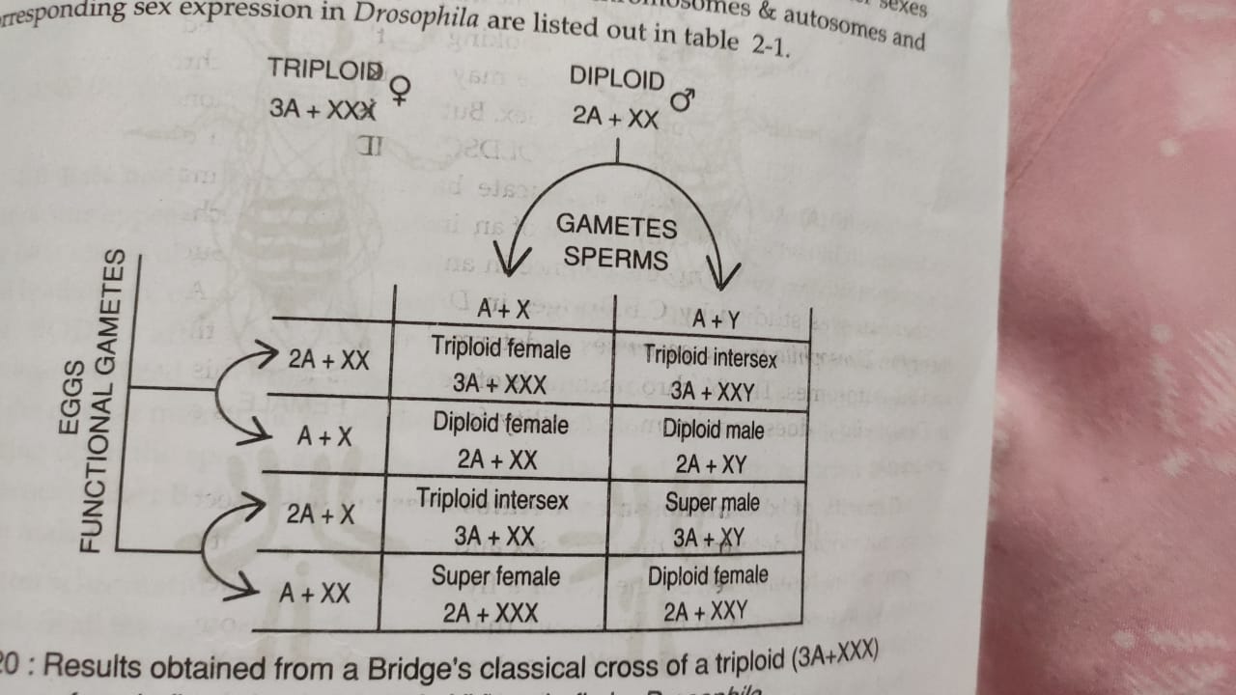
Experiments of bridges
Bridges could succeeded in producing a triploid female (AAA+ XXX) because of the phenomenon of Non disjunction

Slide 16
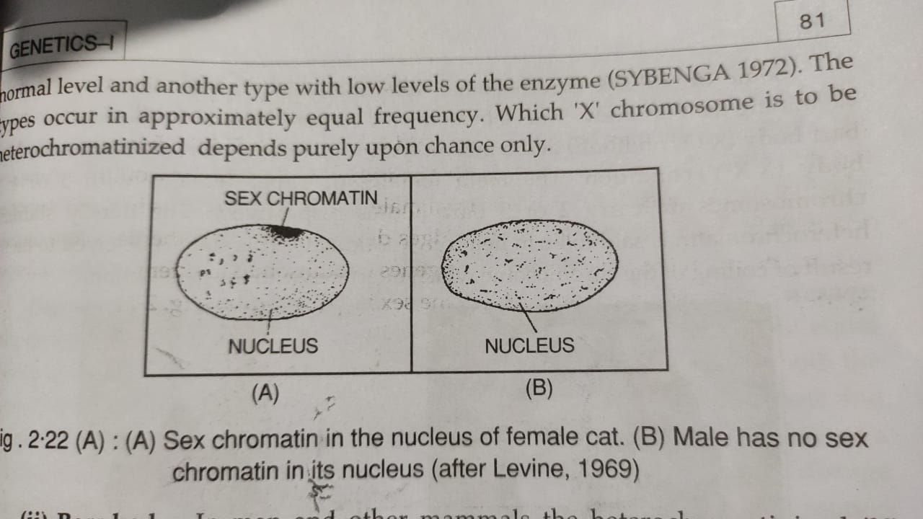
Barrbody
A densely staining inactivated condensed x chromosome that is present in each somatic cell of most female mammals and is used as a test of genetic femaleness.

Slide 17
Conclusion
So after all these observations we concluded that the sex determination is not in our control, it is based on our chromosomes

Slide 18
THANK YOU

